Slide 1

AirLytics – Smart Air Quality Prediction System
Predictive Analytics for Environmental Monitoring using Machine Learning, Data Analytics, and Cloud Deployment
MACHINE LEARNING
DATA ANALYTICS
CLOUD DEPLOYMENT
Haldia Institute of Technology | Academic Year 2025–2026
Team: Sayantan Mondal, Soumya Byabarta, Shuvam Mondal

Slide 2

Problem Statement
Air pollution represents a critical public health and environmental challenge affecting millions globally. The Air Quality Index depends on complex, dynamic interactions between multiple pollutants, weather conditions, and seasonal patterns.
Current Limitations
Performance Gaps
Our Solution
A scalable, predictive, and interpretable AQI forecasting system powered by machine learning
Traditional monitoring systems are reactive rather than predictive, failing to provide advance warnings
Existing approaches struggle with handling extreme AQI events and rapid pollution fluctuations

Slide 3
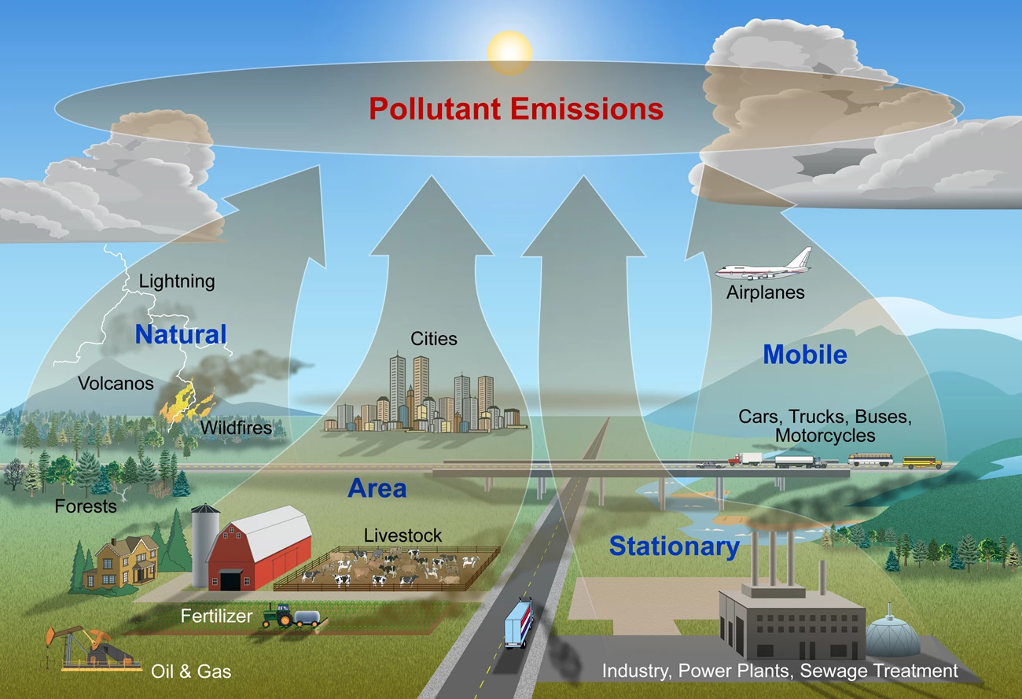
Project Objectives
01
AQI Prediction
Build regression models to accurately predict Air Quality Index values
02
Health Classification
Classify AQI into health-based categories for public awareness
03
Trend Analysis
Analyze pollution patterns across states, seasons, and temporal dimensions
04
Full Deployment
Create a production-ready end-to-end ML system
05
Model Transparency
Ensure explainability and interpretability using SHAP analysis

Slide 4




Project Value & Real-World Impact
Early Warning System
Smart City Planning
Provides advance alerts for extreme pollution events, enabling proactive public health responses and emergency preparedness
Supports urban planning decisions and policy-making with data-driven insights for sustainable city development
Actionable Intelligence
Production Deployment
Transforms raw environmental data into meaningful, actionable insights for stakeholders and decision-makers
Demonstrates complete ML lifecycle: model development, backend APIs, frontend interface, and cloud infrastructure

Slide 5
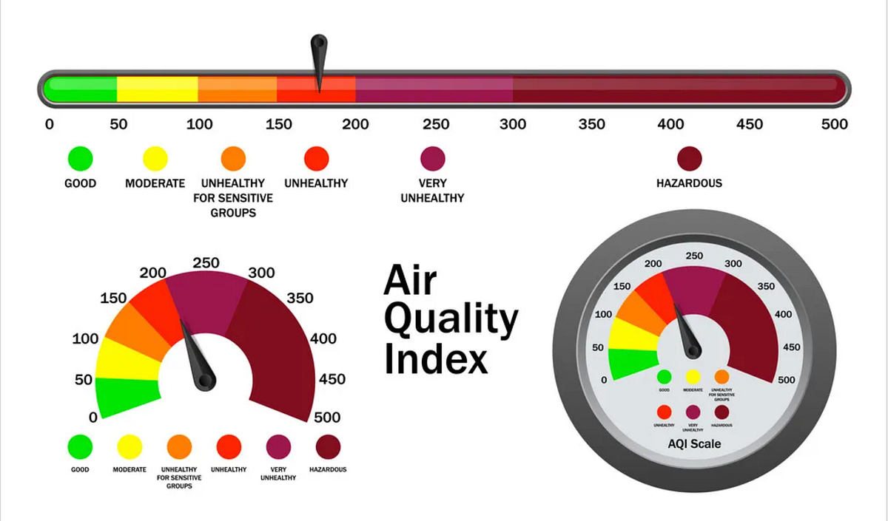
Dataset Overview
Data Source
State-wise Air Quality Index data from India, comprising comprehensive environmental and meteorological measurements
Feature Categories
Pollutants: PM2.5, PM10, NO₂, CO, SO₂, O₃
Weather: Temperature, Humidity, Wind Speed
Temporal: Year, Month, Season
Target Variables
AQI Value: Continuous prediction (Regression)
AQI Bucket: Category classification (Good, Moderate, Poor, etc.)

Slide 6
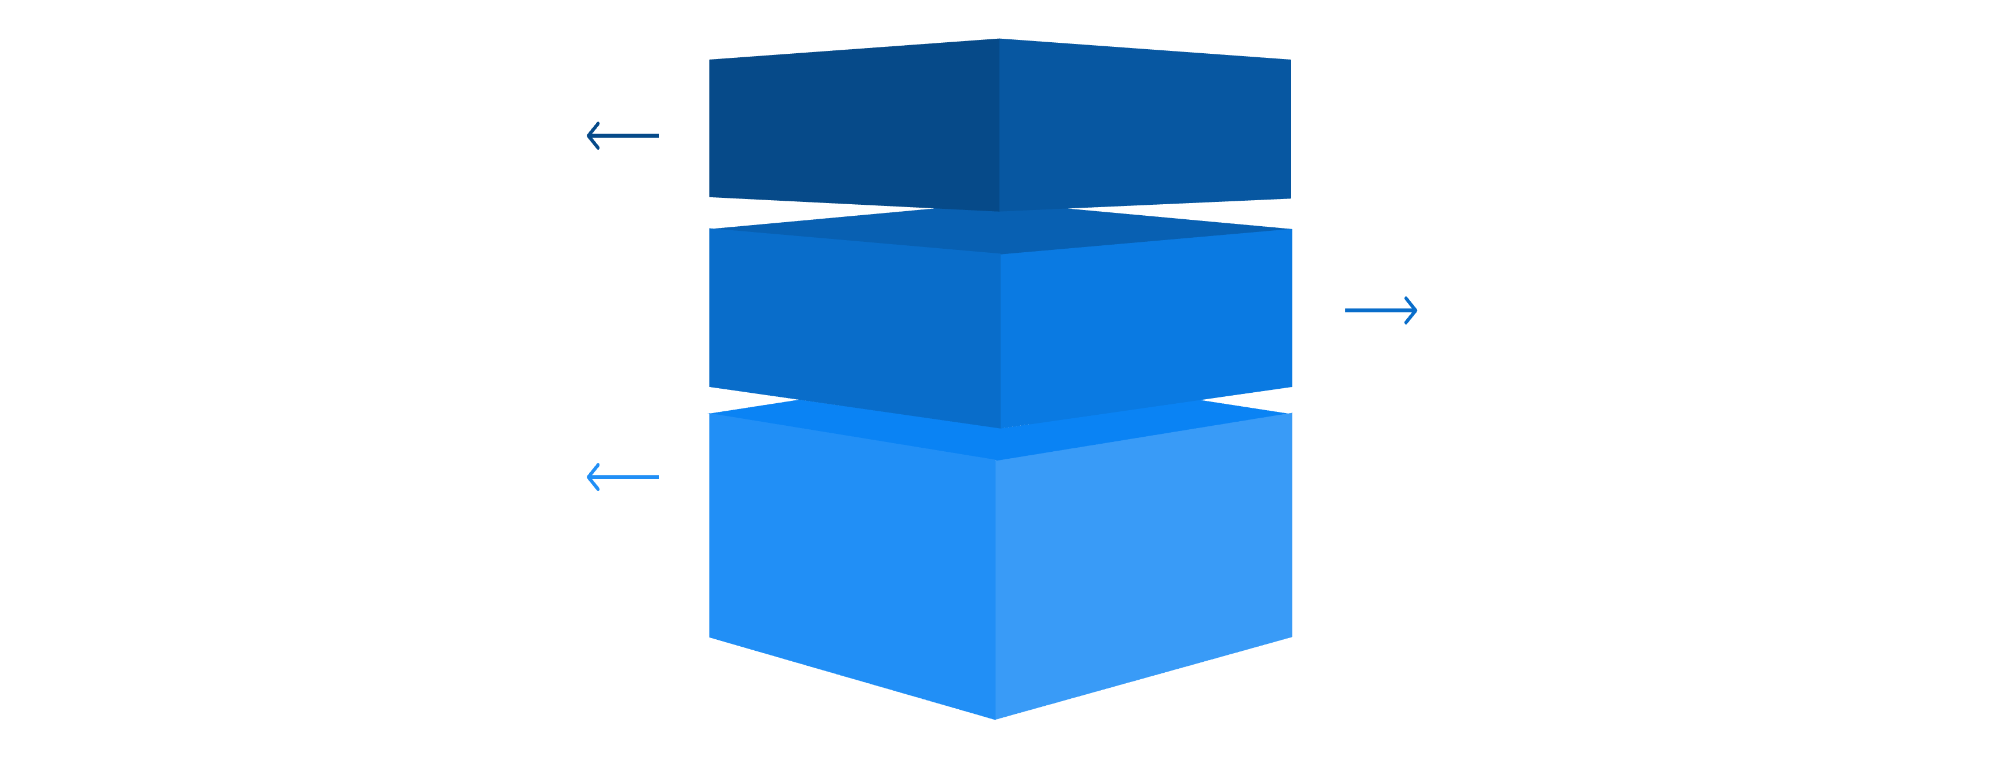
System Architecture
AirLytics follows a modern three-tier architecture that separates concerns and enables scalable deployment across cloud platforms
ML Layer
Train and evaluate models in Google Colab.
Backend API
Host FastAPI on Render for model inference.
Frontend Layer
Deploy interactive dashboards on Netlify.
This architecture ensures modularity, allowing independent scaling and updates for each component while maintaining seamless integration

Slide 7
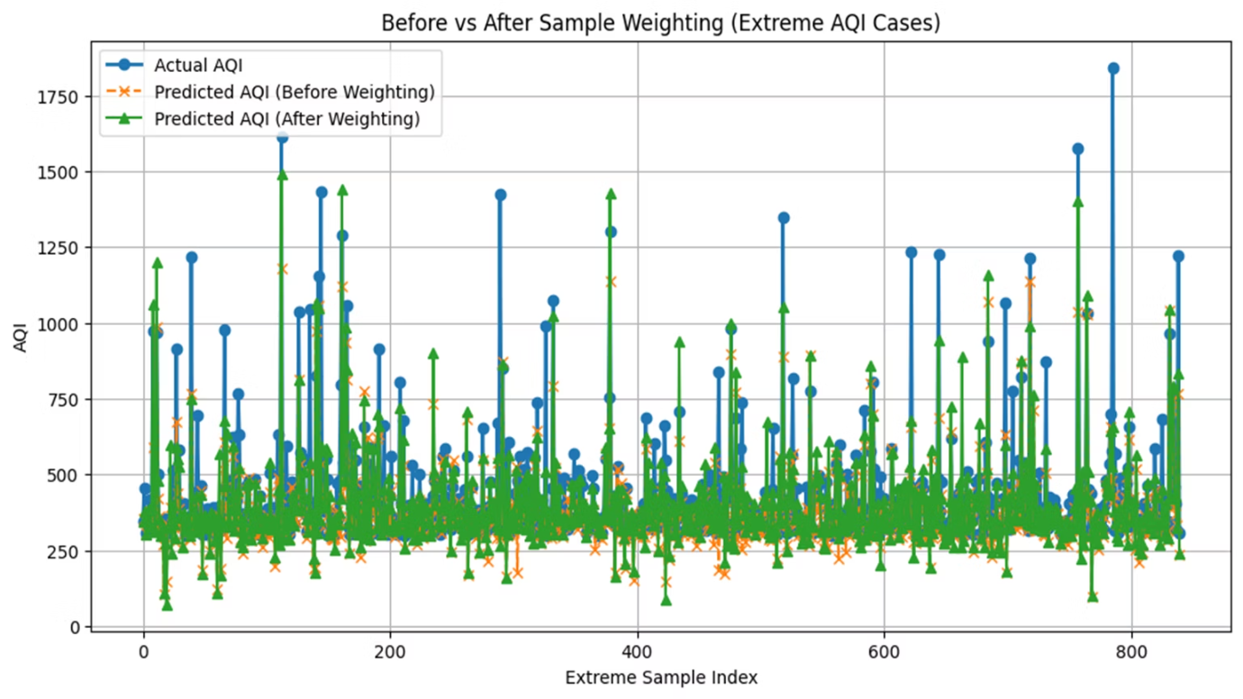






Machine Learning Pipeline
Data Validation
Cleaning and quality checks
Feature Engineering
Creating predictive features
Train-Test Split
Time-based validation
Model Training
XGBoost optimization
Evaluation
Performance metrics
Explainability
SHAP analysis

Slide 8
Model Architecture & Optimization
Architecture Evolution
Before
After
Transitioned from Random Forest to XGBoost for superior predictive accuracy and better handling of non-linear relationships in pollution patterns
180+ MB model size
~3 MB optimized model
Slow API response
Fast inference time
Performance Optimization
High memory usage
Low resource consumption
Achieved dramatic model compression from 180MB+ to ~3MB, resulting in significantly reduced API latency, faster load times, and minimal memory footprint

Slide 9
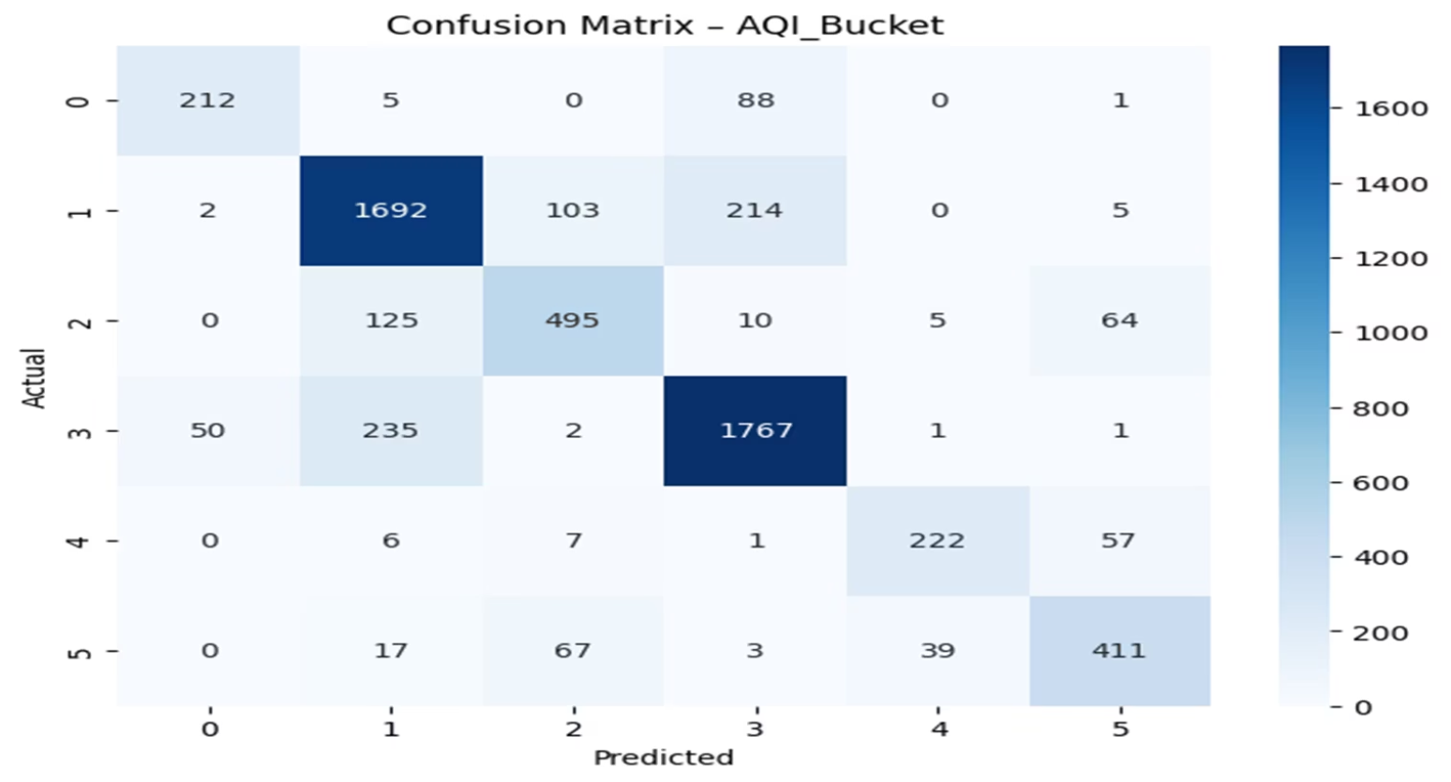
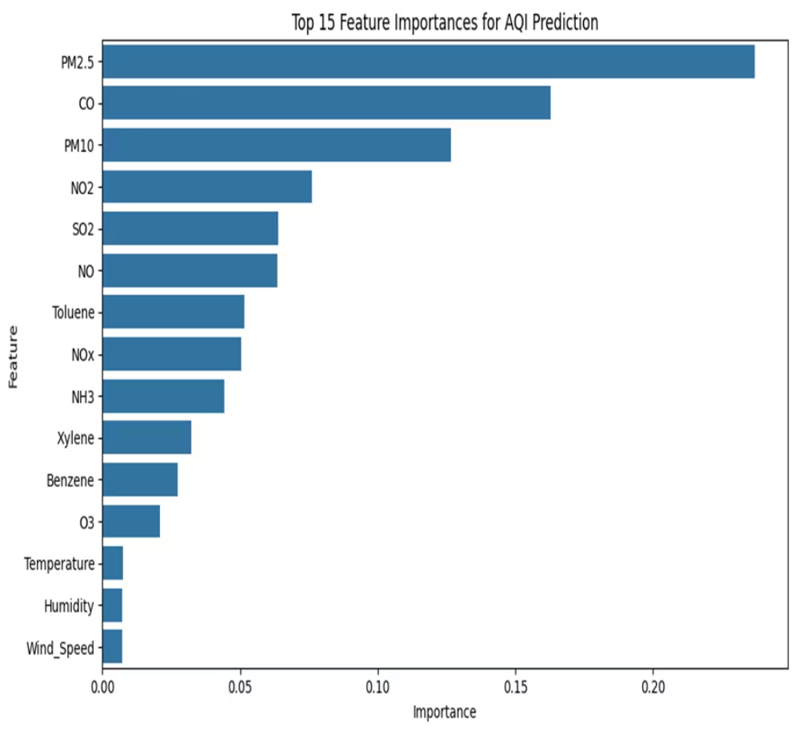
Model Explainability & Feature Importance
Key Pollutant Contributors
Feature importance analysis reveals the primary drivers of AQI predictions:
PM2.5 – Fine particulate matter
CO – Carbon monoxide levels
PM10 – Coarse particulate matter
NO₂ – Nitrogen dioxide
SO₂ – Sulfur dioxide
SHAP Analysis
We implemented SHAP (SHapley Additive exPlanations) for both global feature impact analysis and local explanations of individual predictions, improving model transparency and stakeholder trust

Slide 10



Deployment, Monitoring & Future Vision
Cloud Infrastructure
System Monitoring
Future Enhancements
Training: Google Colab
Cron job health checks every 5 minutes ensure backend availability and faster failure detection
Real-time predictions, IoT integration, GIS mapping, LSTM models, mobile alerts
Backend: Render (FastAPI)
Frontend: Netlify
Storage: GitHub (version control)
Key Results
Successfully deployed a production-ready ML system demonstrating strong predictive performance, stable seasonal behavior, and optimized inference speed. AirLytics showcases the complete integration of machine learning, cloud infrastructure, and full-stack development applied to critical environmental challenges.
Thank you! Explore AirLytics at airlytics-live.netlify.app | Team: Sayantan, Soumya, Shuvam

